Slide 1
Foundation of Computer Science
Lecture 5
Rules of Inference

Slide 2
Outline
Mathematical Argument
Rules of Inference

Slide 3
Argument
In mathematics, an argument is a sequence of propositions (called premises) followed by a proposition (called conclusion)
A valid argument is one that, if all its premises are true, then the conclusion is true.

Slide 4
Valid Argument Form
By definition, if a valid argument form consists
premises:
conclusion:
p₁, p₂, … , p_{k} q
then ( p₁ ∧ p₂ ∧ … ∧ p_{k} ) → q is a tautology
Ex: ( ( p → q ) ∧ p ) → q is a tautology
Some simple valid argument forms, called rules of inference, are derived and can be used to construct complicated argument form

Slide 5
Valid Argument Form
Example :
“If it rains, I drive to school.”
“It rains.”
“I drive to school.”
p → q p
∴ q
This is called a valid argument form
The argument is valid since ((p → q) ^ p) → q is a tautology.

Slide 6
Rules of Inference
(method of affirming) p, p → q
q
1. Modus Ponens
premises: conclusion:
2. Modus Tollens
(method of denying)
¬ q, p → q
¬ p
premises: conclusion:

Slide 7
Rules of Inference
3. Hypothetical Syllogism
premises: | p → q, |  | q → r
conclusion: | p → r
Disjunctive Syllogism
premises: | ¬ p, | p ∨ q
conclusion: | q
4.

Slide 8
Rules of Inference
Addition premises: p conclusion: p ∨ q
Simplification premises: p ∧ q conclusion: p

Slide 9
Rules of Inference
7. Conjunction premises: p, q conclusion: p ∧ q
8. Resolution premises: p ∨ q, conclusion: q ∨ r
¬ p ∨ r

Slide 10
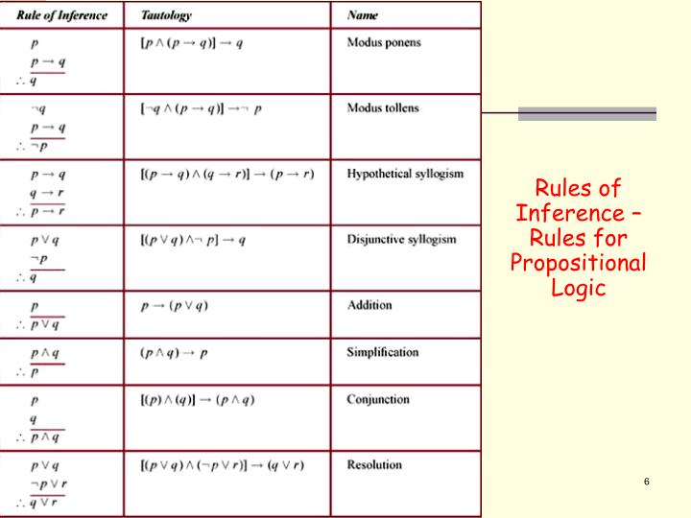

Slide 11
Applying Rules of Inferences
Example 1: It is known that
It is not sunny this afternoon, and it is colder than yesterday.
We will go swimming only if it is sunny.
If we do not go swimming, we will play basketball.
If we play basketball, we will go home early.
Can you conclude “we will go home early”?

Slide 12
Solution
To simplify the discussion, let
p := It is sunny this afternoon
q := It is colder than Yesterday r := We will go swimming
s := We will play basketball
t := We will go home early
We will give a valid argument with
premises: ¬ p ∧ r, r → p, ¬ r → s, s → t conclusion: t

Slide 13
Solution
Step
¬ p ∧ r
¬ p
r → p
¬ r
¬ r → s
Reason
Premise
Simplification using (1) Premise
Modus Tollens using (2) and (3) Premise
Modus Ponens using (4) and (5) Premise
Modus Ponens using (6) and (7)
s
s → t
t

Slide 14
Applying Rules of Inferences
Example 2: It is known that
If you send me an email, then I will finish my program.
If you do not send me an email, then I will go to sleep early.
If I go to sleep early, I will wake up refreshed.
Can you conclude “If I do not finish my program, then I will wake up refreshed”?

Slide 15
Solution
To simplify the discussion,
let p := You send me an email
q := I finish my program
r := I go to sleep early
s := I wake up refreshed
We will give a valid argument with
premises: conclusion:
p → q, ¬ p → r, r → s
¬ q → s

Slide 16
Solution
Step
p → q
¬ q → ¬ p
¬ p → r
¬ q → r
r → s
¬ q → s
Reason
Premise Contrapositive of (1) Premise
Hypothetical Syllogism by (2) and (3) Premise
Hypothetical syllogism by (4) and (5)

Slide 17
Show that the hypotheses:
It is not sunny this afternoon and it is colder than yesterday. ¬s ∧ c
We will go swimming only if it is sunny. w → s
If we do not go swimming, then we will take a canoe trip. ¬w → t
If we take a canoe trip, then we will be home by sunset. t → h
lead to the conclusion:
We will be home by the sunset. h
Step Reason
1. ¬s ∧ c hypothesis
2. ¬s simplification
3. w → s hypothesis
4. ¬w modus tollens of 2 and 3
5. ¬w → t hypothesis
6. t modus ponens of 4 and 5
7. t → h hypothesis
8. h modus ponens of 6 and 7

Slide 18
Thank You

